Slide 1
Block diagram of electrical components
V1.8
nRF5340
V1.8
V3.3
1.8V
->
3.3V
micro SD
Card
Level Shifter
/CS_V1.8
/CS_V3.3
SPIM4_ CSN
P0.11
DAT3/CS
SCLK_V1.8
SCLK_V3.3
SPIM4_SCLK
CLK
P0.08
DI_V1.8
DI_V3.3
SPIM4_ MOSI
P0.09
CMD/DI
SPIM4_ MISO
DO_V1.8
DO_V3.3
DO
P0.10
Used as SPI Mode

Slide 2
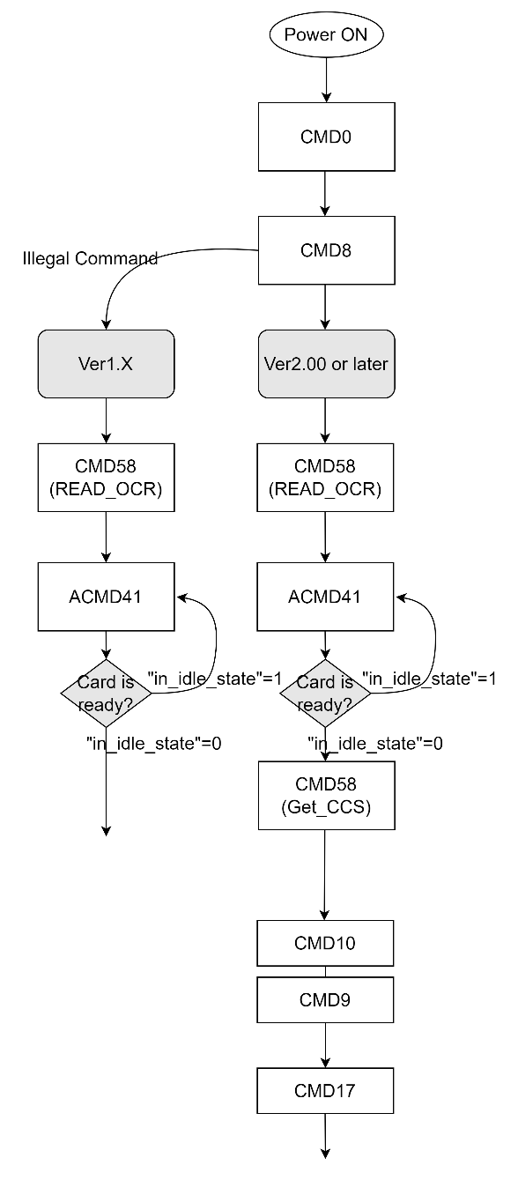
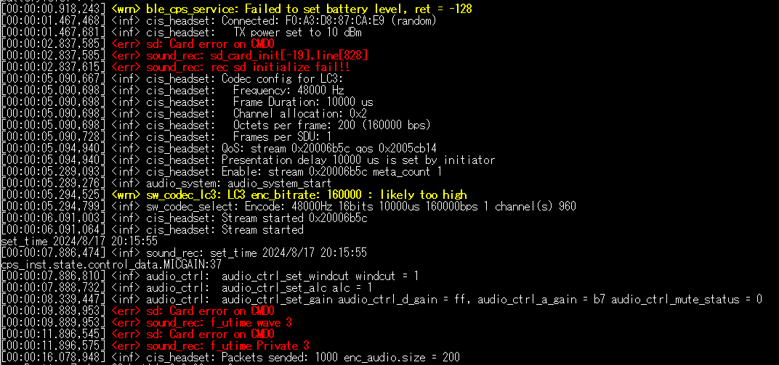
Case A
CMD0
Point of Communication Termination (Case Ａ)
CMD0
Card-identification mode
Data-transfer mode
The communication terminates at the first command of the initialization flow (CMD0).

Slide 3
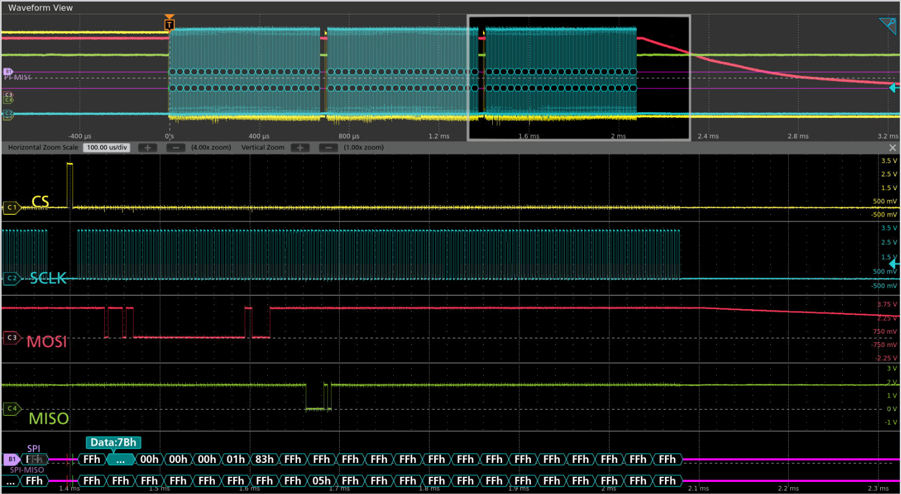
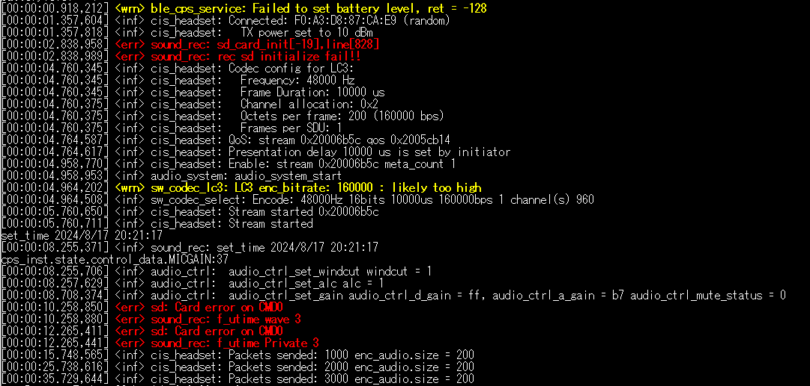
Case B
CMD0
CMD8
CMD59
Illegal Response
01 Response
ＣＭＤ0 CMD8 CMD59
01 Response
Point of Communication Termination (Case B)
CMD59
Illegal Response
CMD59
Card-identification mode
Data-transfer mode
The communication terminates at CMD59 with an illegal response.

Slide 4
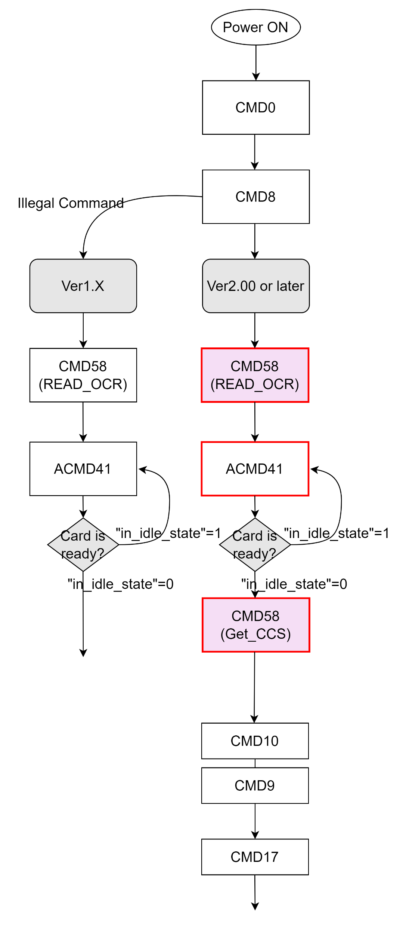
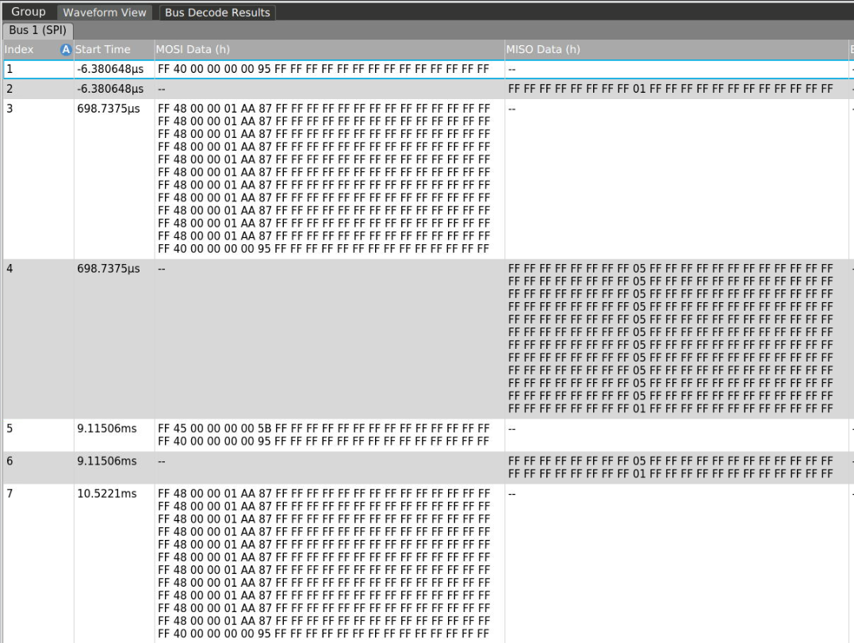
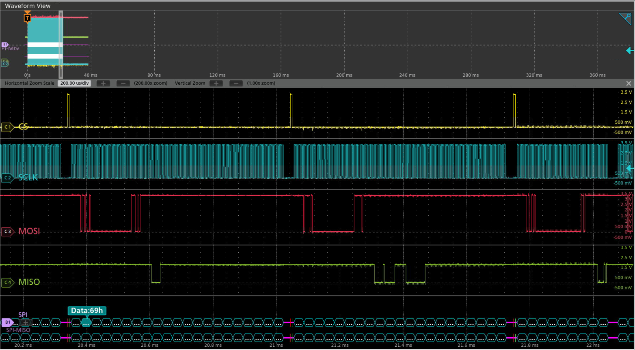
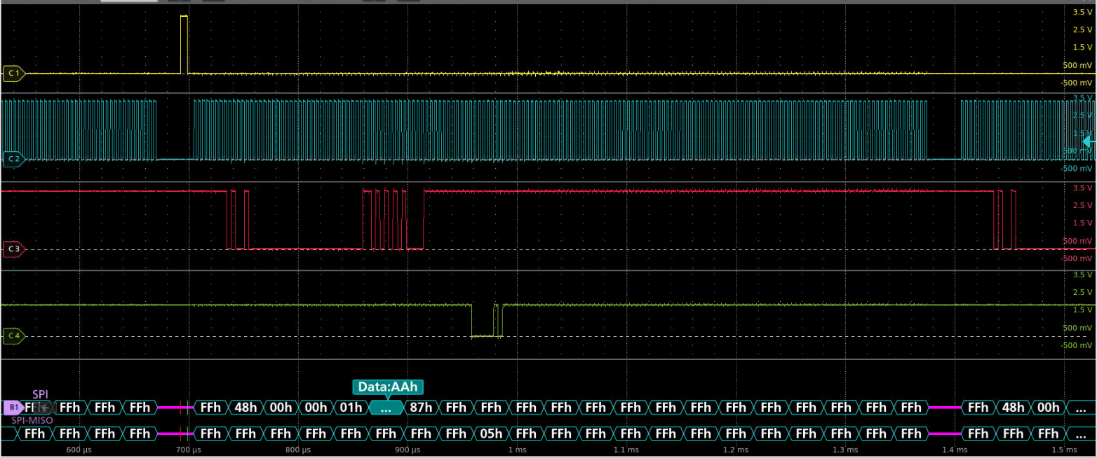
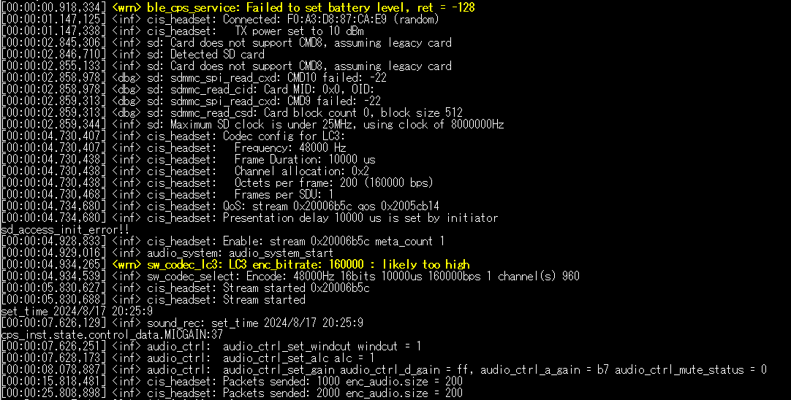
Case C
CMD58
CMD0
CMD5５
ＡCMDＡ41
Incomplete Initialization
CMD8
CMD58
CMD10
CMD9
Illegal Response
Card-identification mode
Data-transfer mode
Illegal Response
ＡCMDＡ41
CMD58
CMD10
CMD8
CMD8
01
Incomplete Initialization
Illegal Response
Resend ＣＭＤ８
Card-identification mode
Data-transfer mode
Point of Communication Termination (Case C)
・Respond with an illegal response to CMD8.
・Transit Data-transfer mode despite incomplete initialization.

Slide 5
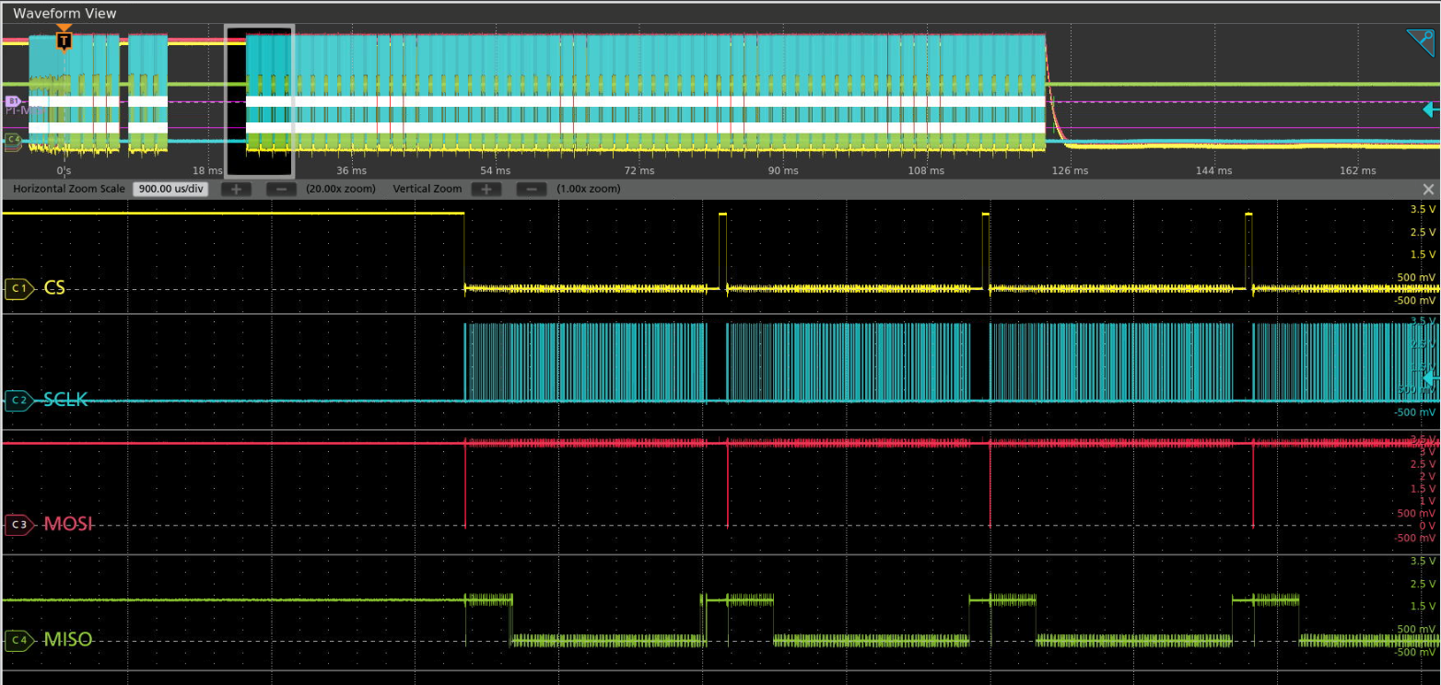
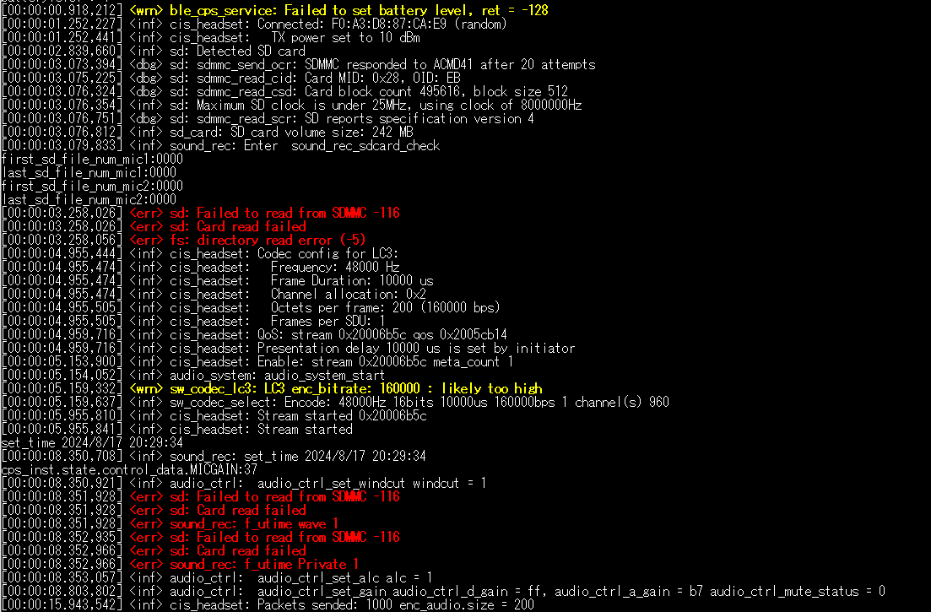
Case D
CMD17
CMD17
Failed to read data
Card-identification mode
Data-transfer mode
Point of Communication Termination (Case D)
・The initialization flow completed successfully
・ Failed to read data and terminated

