Slide 1
SWF vs Coaxial probe
nRF52832 DK, +4dBm, Ch 40

Slide 2
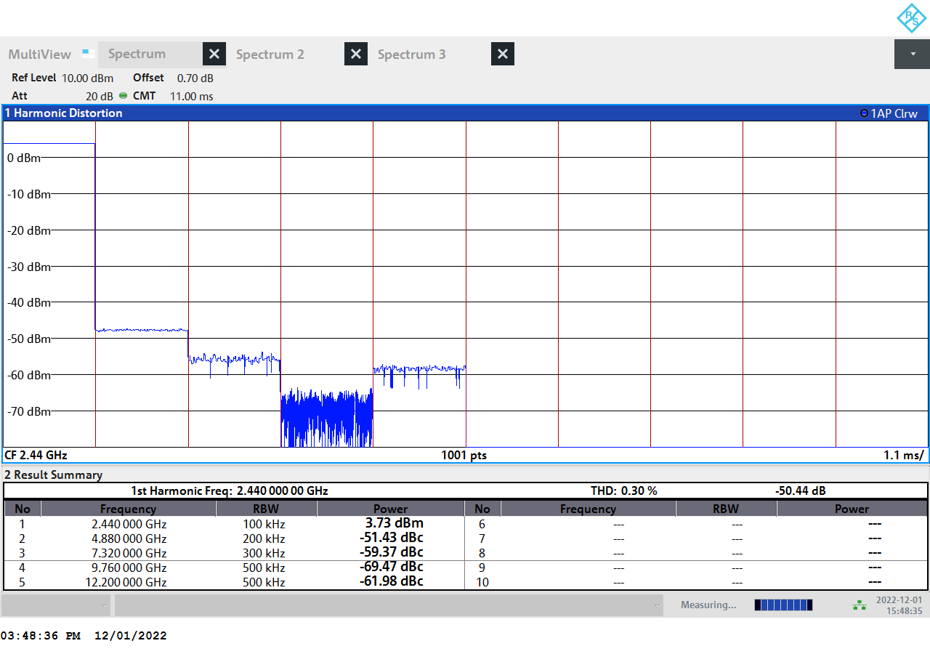
SWF connector

Slide 3
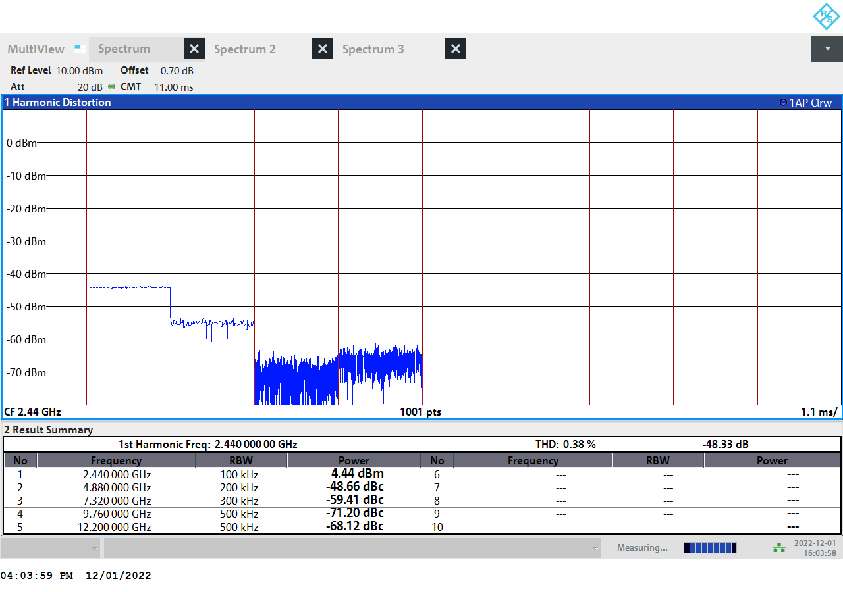
Coaxial connector

