Slide 1
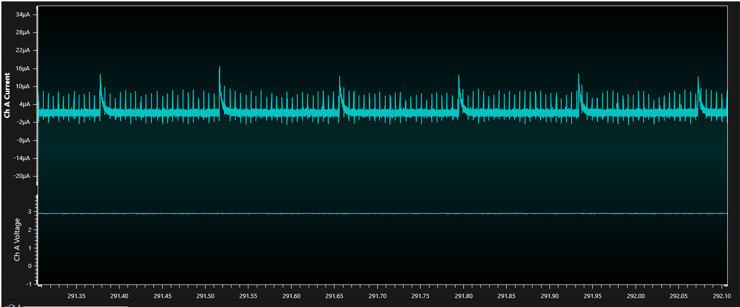
nRF52840. In case of standby current (battery only)
The current is consumed as shown in the experiment below.

Slide 2
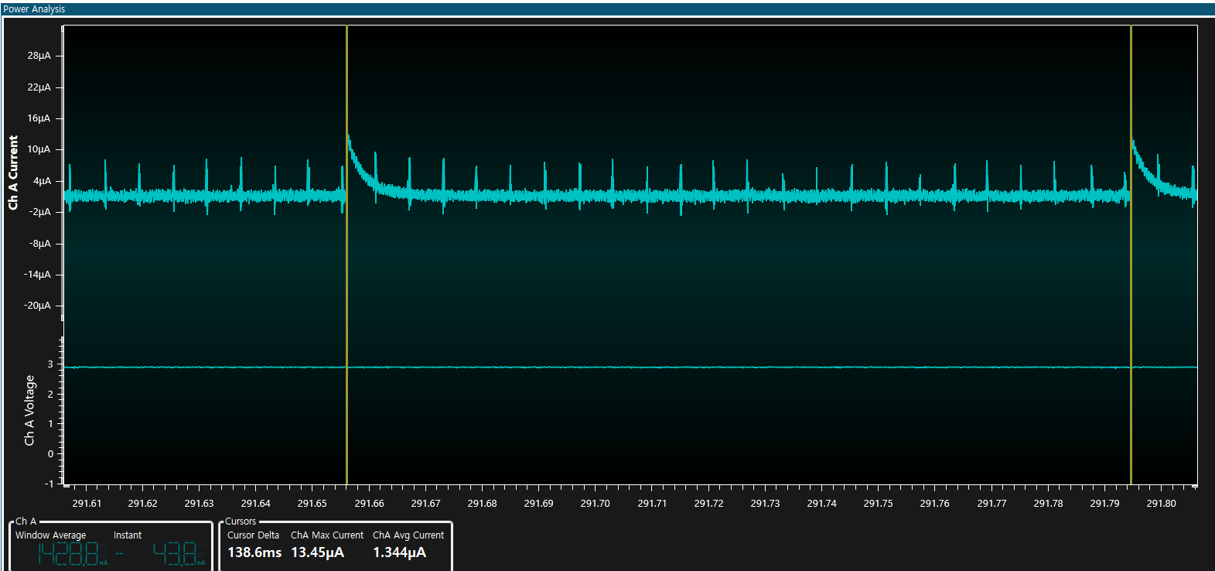
3 page
Expand test results 1
About 13uA peak every 138ms

Slide 3
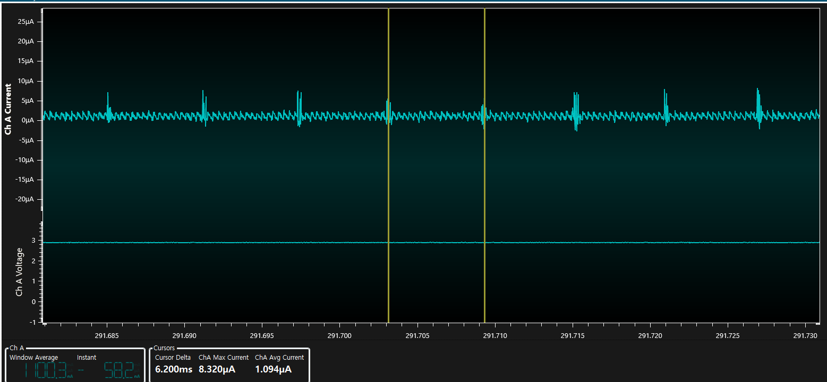
Expand test results 2
About 8uA peak every 6ms

