Slide 1
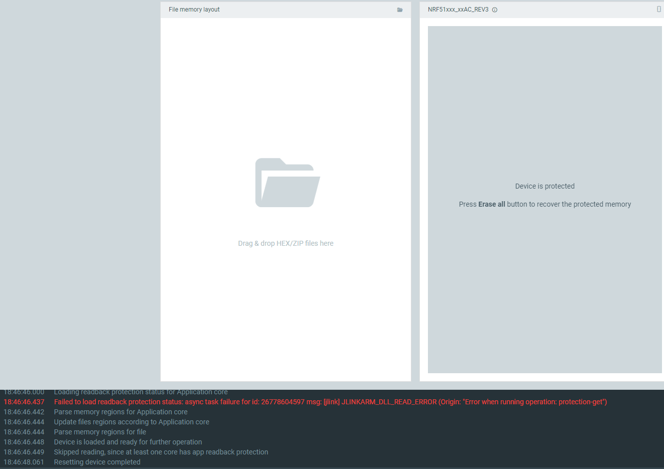
Chip reading and protection error

Slide 2
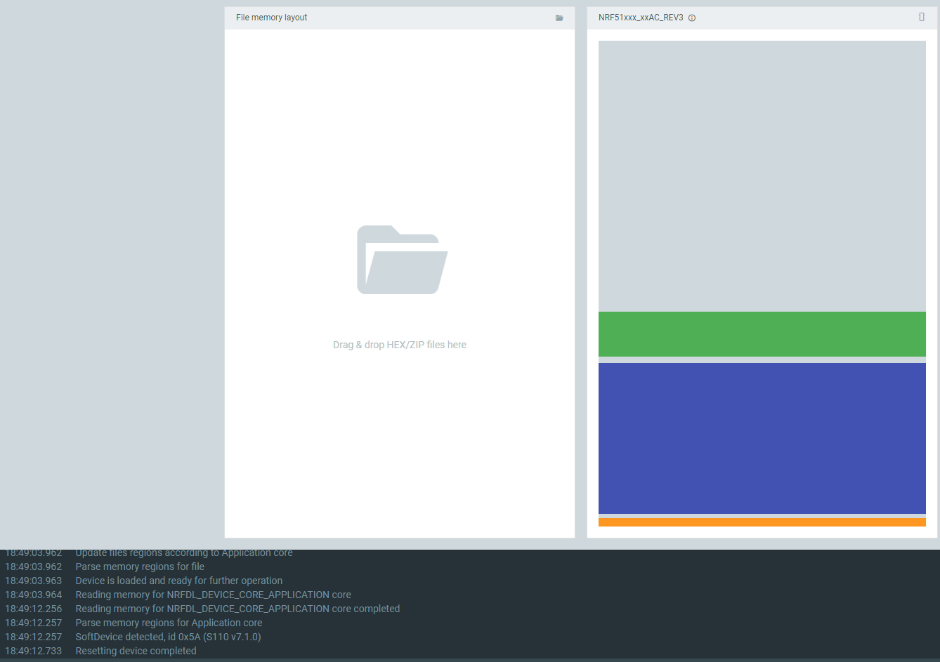
nRF5 DK connection

Slide 3
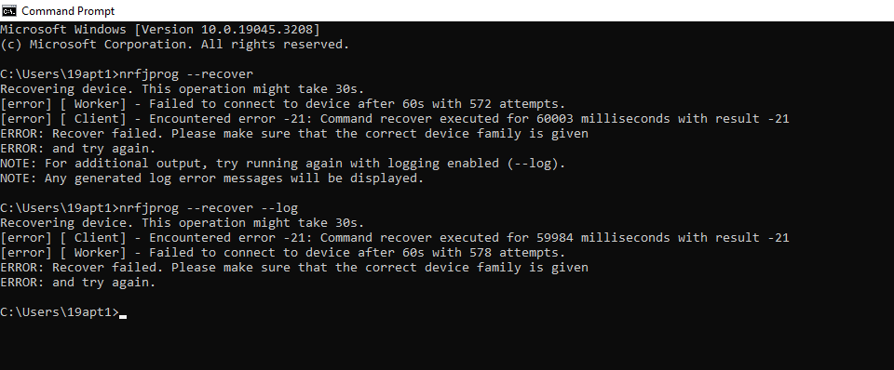
Nrfjprog –recovery results

Slide 4
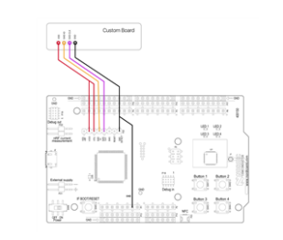
Chip to DK circuit layout for providing power supply

